Slide 1


DATABASE MANAGEMENT SYSTEM

Slide 2
Database Model
Data Model -Definition
A Database model defines the logical design and structure of a database and defines how data will be stored, accessed and updated in a database management system
Types of Data Model
Hierarchical Model
Network Model
Entity-Relationship Model
Relational Model

Slide 3
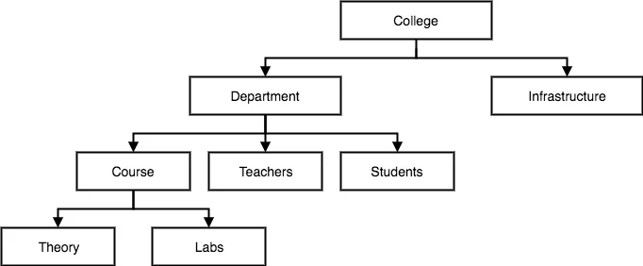
Database Model
Hierarchical model
It organises data into a tree-like-structure, with a single root, to which all the other data is linked.
Heirarchy starts from the Root data, and expands like a tree, adding child nodes to the parent nodes.
In this model, a child node will only have a single parent node.
This model efficiently describes many real-world relationships like index of a book, recipes etc.
one-to-many relationship

Slide 4
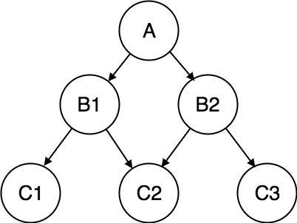
Database Model
Network model
It organises data into more like a graph, and are allowed to have more than one parent node.
In this database model data is more related as more relationships are established in this database model.
Also, as the data is more related, hence accessing the data is also easier and fast.
This model efficiently describes many real-world relationships like index of a book, recipes etc.
This was the most widely used database model, before Relational Model was introduced.
many-to-many relationship

Slide 5
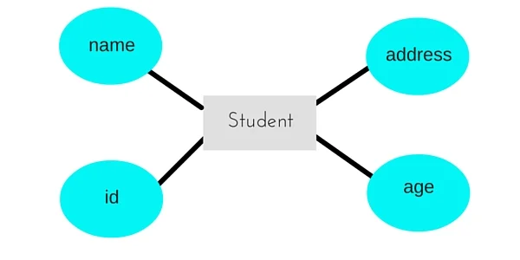
Database Model
Entity-relationship Model
In this database model relationships are created by dividing object of interest into entity and its characteristics into attributes.
Different entities are related using relationships.
E-R Models are defined to represent the relationships into pictorial form to make it easier for different stakeholders to understand.
This model is good to design a database, which can then be turned into tables in relational model
Entity –Student
Attributes – Name, Age, Address, id

Slide 6
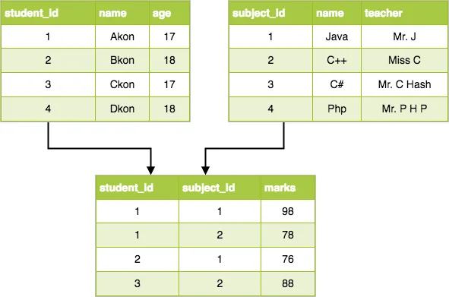
Database Model
Relational Model
In this database model data is organised in two-dimensional tables and the relationship is maintained by storing a common field.
This model was introduced by E.F Codd in 1970, and since then it has been the most widely used database model, infact, we can say the only database model used around the world.
The basic structure of data in the relational model is tables. All the information related to a particular type is stored in rows of that table. Tables are also known as relations in relational model.

Slide 7
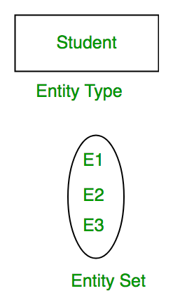
E-R MODEL
Entity-relationship model is a model used for design and representation of relationships between data.
To understand about the ER Model, we must understand about:
Entity and Entity Set
What are Attributes? And Types of Attributes.
Keys
Relationships
ER Model: Entity and Entity Set
An Entity is generally a real-world object with a physical existence – a particular person, car, house, or employee – or it may be an object with a conceptual existence – a company, a job, or a university course. which has characteristics and holds relationships in a DBMS.
If a Student is an Entity, then the complete dataset of all the students will be the Entity Set

Slide 8
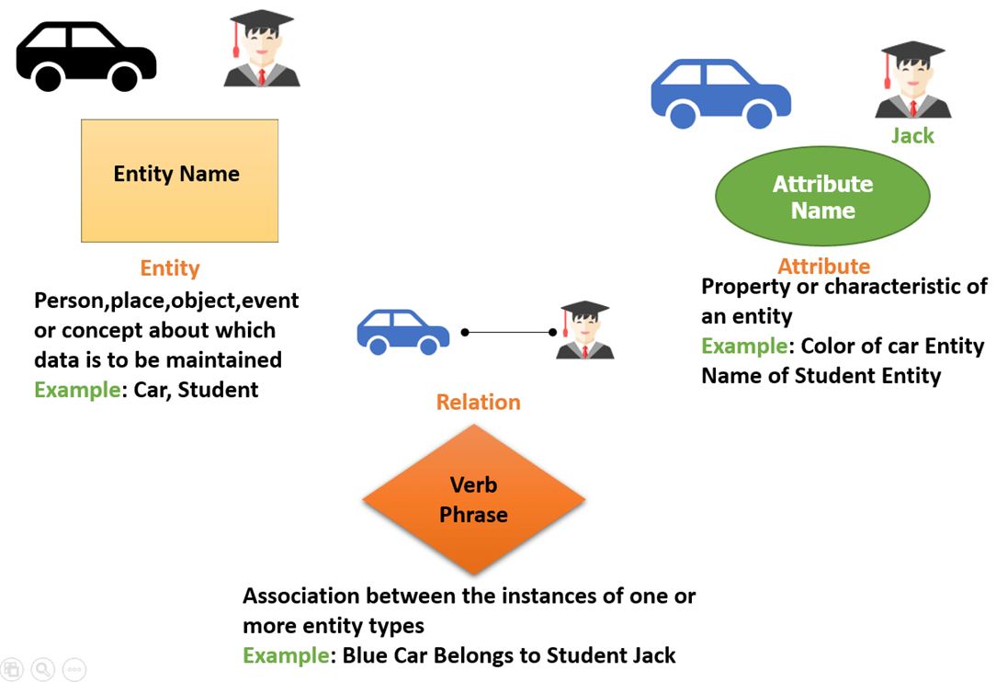
E-R MODEL

Slide 9
E-R MODEL
Types of Attributes | Description
Simple attribute | Simple attributes can't be divided any further. For example, a student's contact number. It is also called an atomic value.
Composite attribute | It is possible to break down composite attribute. For example, a student's full name may be further divided into first name, second name, and last name.
Derived attribute | This type of attribute does not include in the physical database. However, their values are derived from other attributes present in the database. For example, age should not be stored directly. Instead, it should be derived from the DOB of that employee.
Multivalued attribute | Multivalued attributes can have more than one values. For example, a student can have more than one mobile number, email address, etc.

Slide 10
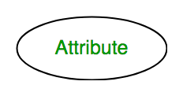
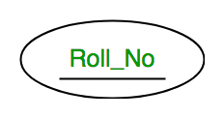
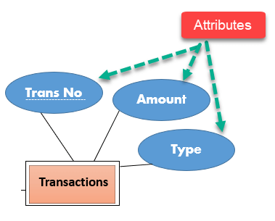
E-R MODEL
ER Model: Attributes
Attributes are the properties which define the entity type. For example, Roll_No, Name, DOB, Age, Address, Mobile_No are the attributes which defines entity type Student. In ER diagram, attribute is represented by an oval.
Key Attribute – The attribute which uniquely identifies each entity in the entity set is called key attribute.For example, Roll_No will be unique for each student. In ER diagram, key attribute is represented by an oval with underlying lines.
Composite Attribute – An attribute composed of many other attribute is called as composite attribute. For example, Address attribute of student Entity type consists of Street, City, State, and Country. In ER diagram, composite attribute is represented by an oval comprising of ovals.

Slide 11
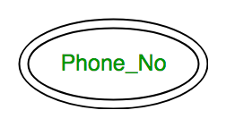
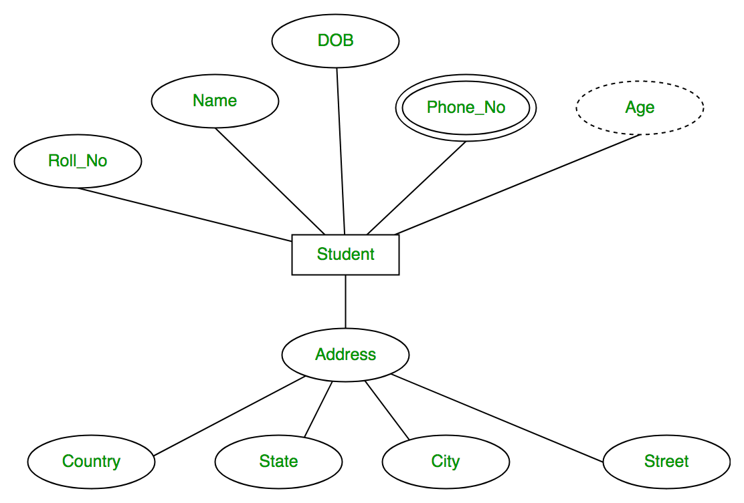
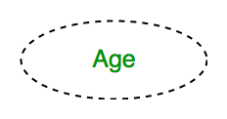
E-R MODEL
Multivalued Attribute –
An attribute consisting more than one value for a given entity. For example, Phone_No (can be more than one for a given student). In ER diagram, multivalued attribute is represented by double oval.
Derived Attribute –
An attribute which can be derived from other attributes of the entity type is known as derived attribute. e.g.; Age (can be derived from DOB). In ER diagram, derived attribute is represented by dashed oval.

Slide 12
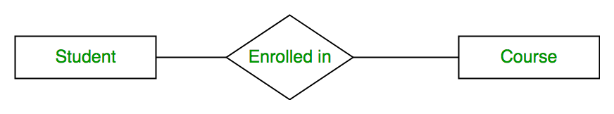
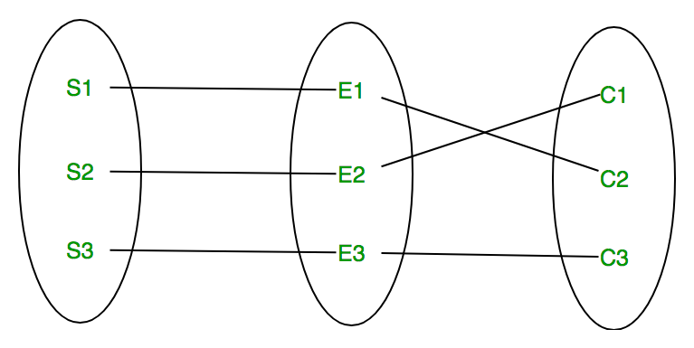
E-R MODEL-
Relationship Type and Relationship Set:
A relationship type represents the association between entity types. For example,‘Enrolled in’ is a relationship type that exists between entity type Student and Course. In ER diagram, relationship type is represented by a diamond and connecting the entities with lines.
A set of relationships of same type is known as Relationship set. The following relationship set depicts S1 is enrolled in C2, S2 is enrolled in C1 and S3 is enrolled in C3.

Slide 13
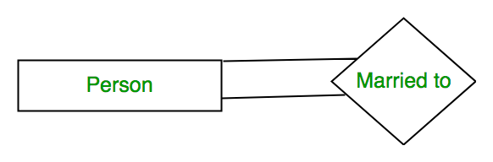
E-R MODEL-
Degree of a relationship set:
The number of different entity sets participating in a relationship set is called as degree of a relationship set.
Unary Relationship – When there is only ONE entity set participating in a relation, the relationship is called as unary relationship. For example, one person is married to only one person.
Binary Relationship – When there are TWO entities set participating in a relation, the relationship is called as binary relationship. For example, Student is enrolled in Course.
n-ary Relationship – When there are n entities set participating in a relation, the relationship is called as n-ary relationship.

Slide 14
E-R MODEL-
Degree of a relationship set:
The number of different entity sets participating in a relationship set is called as degree of a relationship set.
Unary Relationship – When there is only ONE entity set participating in a relation, the relationship is called as unary relationship. For example, one person is married to only one person.
Binary Relationship –
When there are TWO entities set participating in a relation, the relationship is called as binary relationship. For example, Student is enrolled in Course.

Slide 15
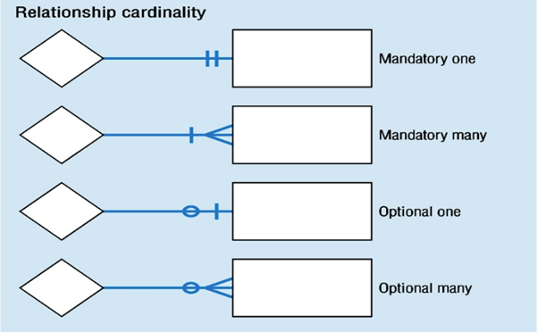
E-R MODEL-
Cardinality
Defines the numerical attributes of the relationship between two entities or entity sets.
Different types of cardinal relationships are:
One-to-One Relationships
One-to-Many Relationships
May to One Relationships
Many-to-Many Relationships

Slide 16
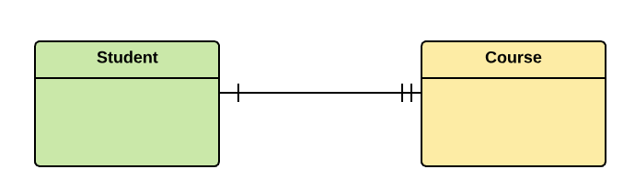
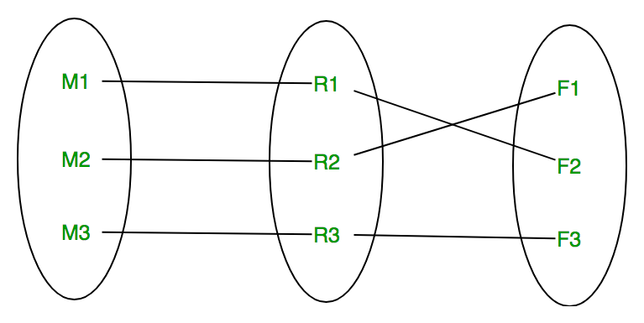
E-R MODEL-
Cardinality:
The number of times an entity of an entity set participates in a relationship set is known as cardinality. Cardinality can be of different types:
One to one – When each entity in each entity set can take part only once in the relationship, the cardinality is one to one. Let us assume that a male can marry to one female and a female can marry to one male. So the relationship will be one to one.
Using Sets, it can be represented as:

Slide 17
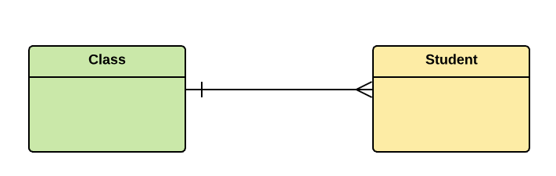
E-R MODEL-
Cardinality:
One-to-many:
One entity from entity set X can be associated with multiple entities of entity set Y, but an entity from entity set Y can be associated with at least one entity.
For example, one class is consisting of multiple students.

Slide 18
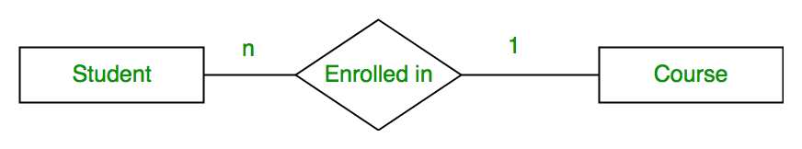
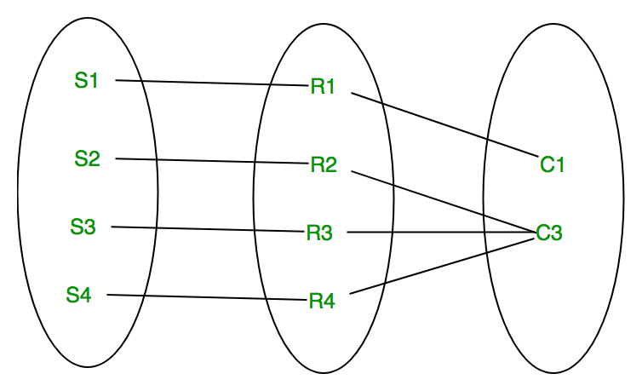
E-R MODEL-
Many to one – When entities in one entity set can take part only once in the relationship set and entities in other entity set can take part more than once in the relationship set, cardinality is many to one. Let us assume that a student can take only one course but one course can be taken by many students. So the cardinality will be n to 1. It means that for one course there can be n students but for one student, there will be only one course.
Using Sets, it can be represented as:

Slide 19
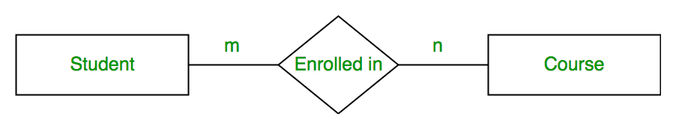
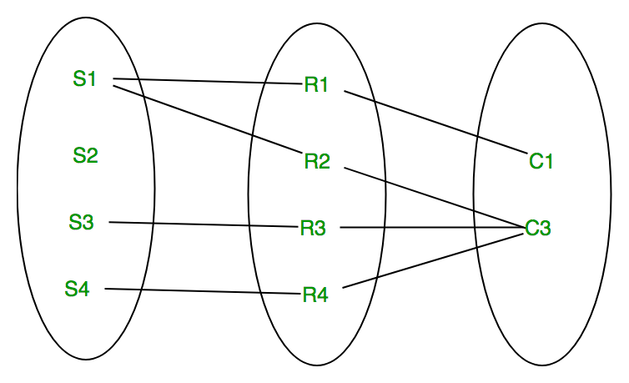
E-R MODEL-
Many to many – When entities in all entity sets can take part more than once in the relationship cardinality is many to many. Let us assume that a student can take more than one course and one course can be taken by many students. So the relationship will be many to many.
Using sets, it can be represented as:
student S1 is enrolled in C1 and C3 and Course C3 is enrolled by S1, S3 and S4. So it is many to many relationships.

Slide 20
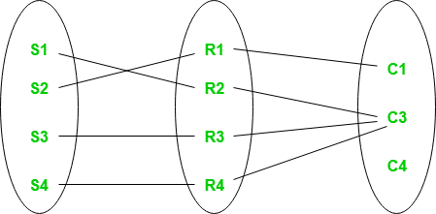
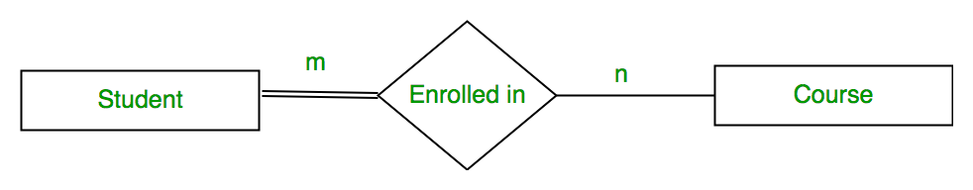
E-R MODEL-
Participation Constraint:
Participation Constraint is applied on the entity participating in the relationship set.
Total Participation – Each entity in the entity set must participate in the relationship. If each student must enroll in a course, the participation of student will be total. Total participation is shown by double line in ER diagram.
Partial Participation – The entity in the entity set may or may NOT participate in the relationship. If some courses are not enrolled by any of the student, the participation of course will be partial.The diagram depicts the ‘Enrolled in’ relationship set with Student Entity set having total participation and Course Entity set having partial participation.

Slide 21
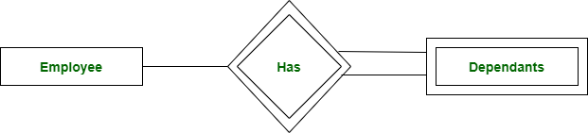
E-R MODEL-
Weak Entity Type and Identifying Relationship:
An entity type has a key attribute which uniquely identifies each entity in the entity set. But there exists some entity type for which key attribute can’t be defined. These are called Weak Entity type.
For example, A company may store the information of dependants (Parents, Children, Spouse) of an Employee. But the dependents don’t have existence without the employee. So Dependent will be weak entity type and Employee will be Identifying Entity type for Dependant.
A weak entity type is represented by a double rectangle. The participation of weak entity type is always total. The relationship between weak entity type and its identifying strong entity type is called identifying relationship and it is represented by double diamond.

Slide 22
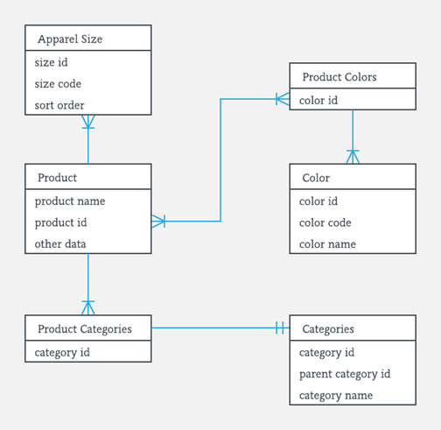
E-R MODEL-

Slide 23
E-R MODEL-
Strong Entity Set | Weak Entity Set
Strong entity set always has a primary key. | It does not have enough attributes to build a primary key.
It is represented by a rectangle symbol. | It is represented by a double rectangle symbol.
It contains a Primary key represented by the underline symbol. | It contains a Partial Key which is represented by a dashed underline symbol.
The member of a strong entity set is called as dominant entity set. | The member of a weak entity set called as a subordinate entity set.
Primary Key is one of its attributes which helps to identify its member. | In a weak entity set, it is a combination of primary key and partial key of the strong entity set.
In the ER diagram the relationship between two strong entity set shown by using a diamond symbol. | The relationship between one strong and a weak entity set shown by using the double diamond symbol.
The connecting line of the strong entity set with the relationship is single. | The line connecting the weak entity set for identifying relationship is double.

